Slide 1
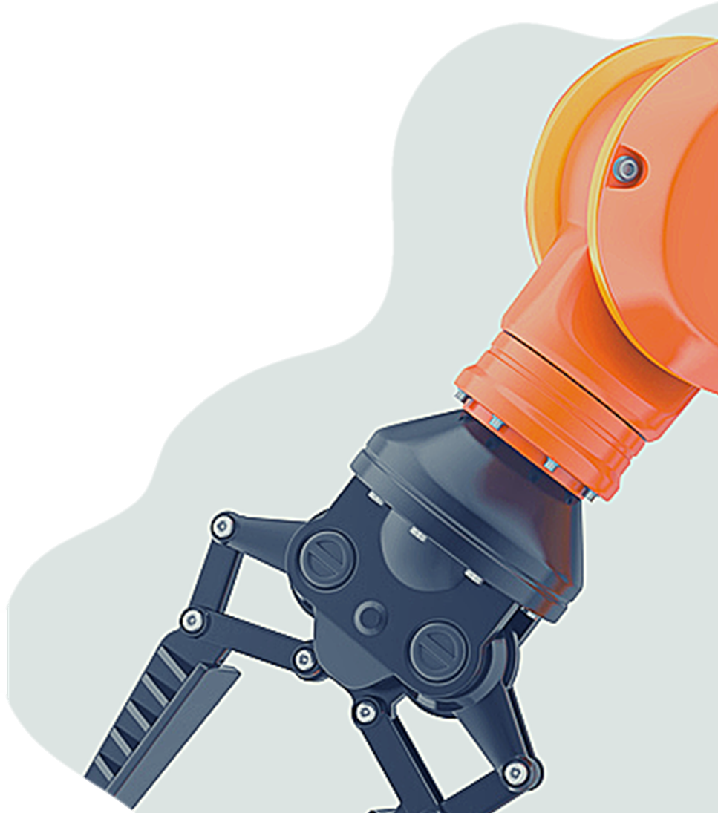
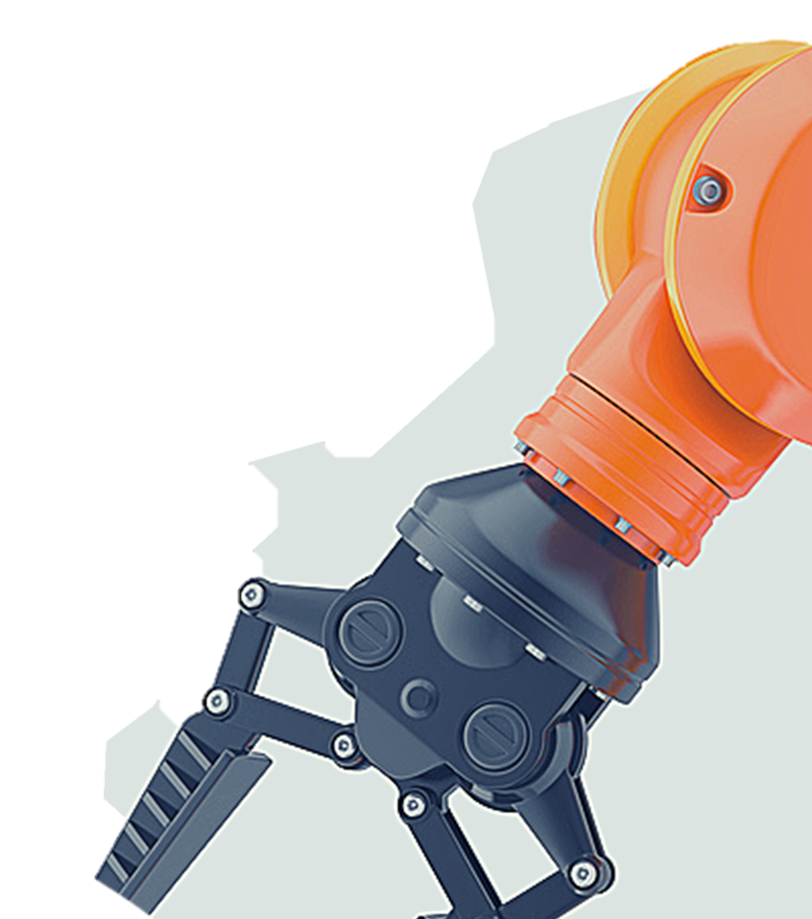

3 JAW GRIPPER
GRIPPER
Team 10
TEAM : 9
Nikhil Singh ME20B2019
Rishikesh Yadav ME20B2040

Slide 2
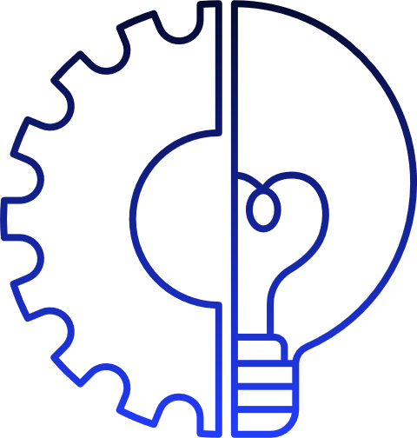

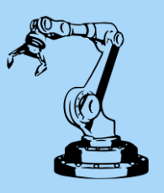

INTRODUCTION
Three Finger Gripper in Brief
Three-finger grippers feature three jaws that close onto the item and hold it in the center.
Commonly used for round or cylindrical items.
Grippers are the most important part of any robotic design or functioning of robot because without gripper it's impossible to perform operation.

Slide 3
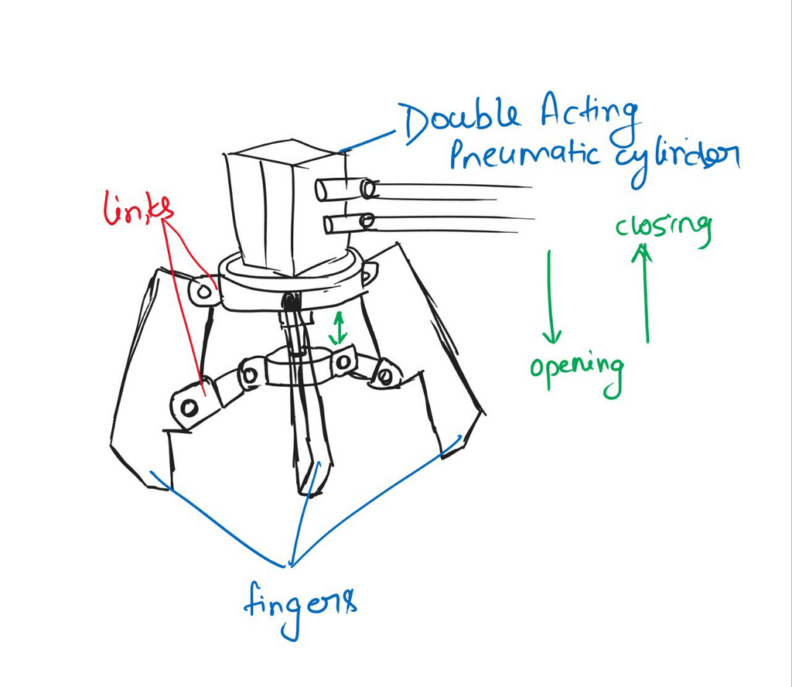
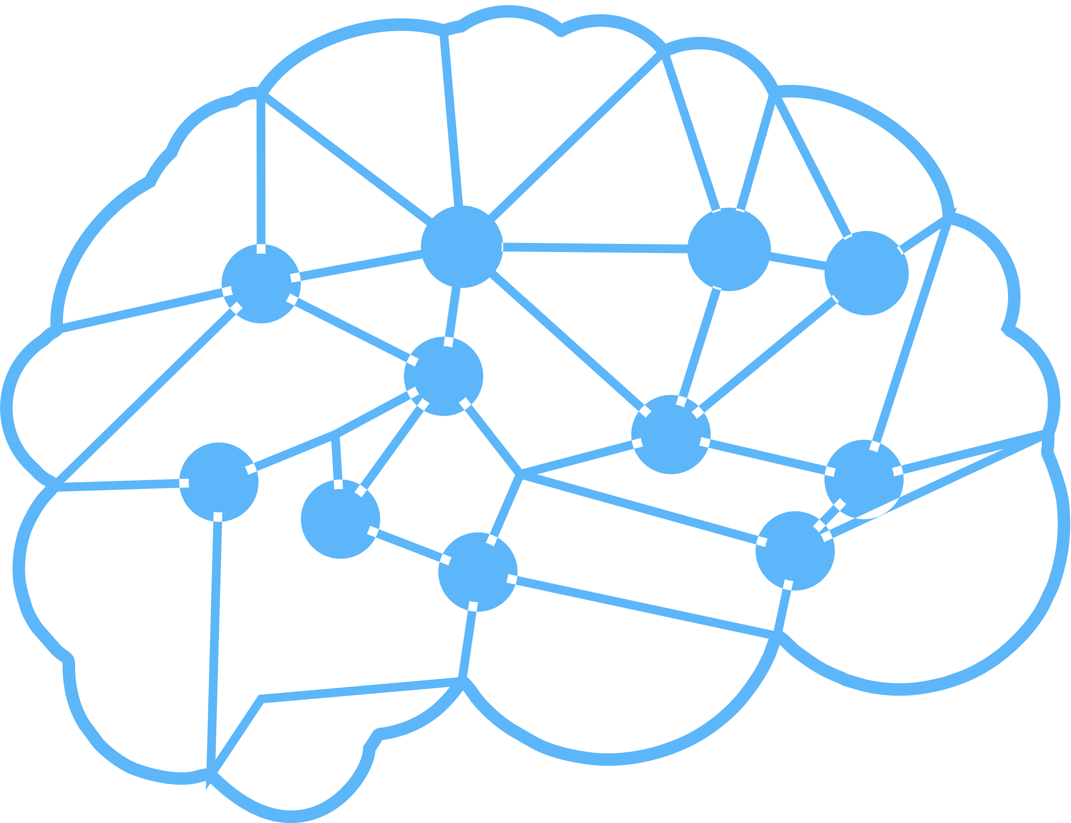
3 Jaw Pneumatic Gripper
Releasing the object
When compressed air is passed double acting cylinder, the rod moves outward, which opens the gripper
Holding the object
When the already filled compressed air is passed double acting cylinder, the rod moves inwards, which closes the gripper
Components
01
Double Acting Actuator
02
Three jaws
03
Links
04
Pins

Slide 4
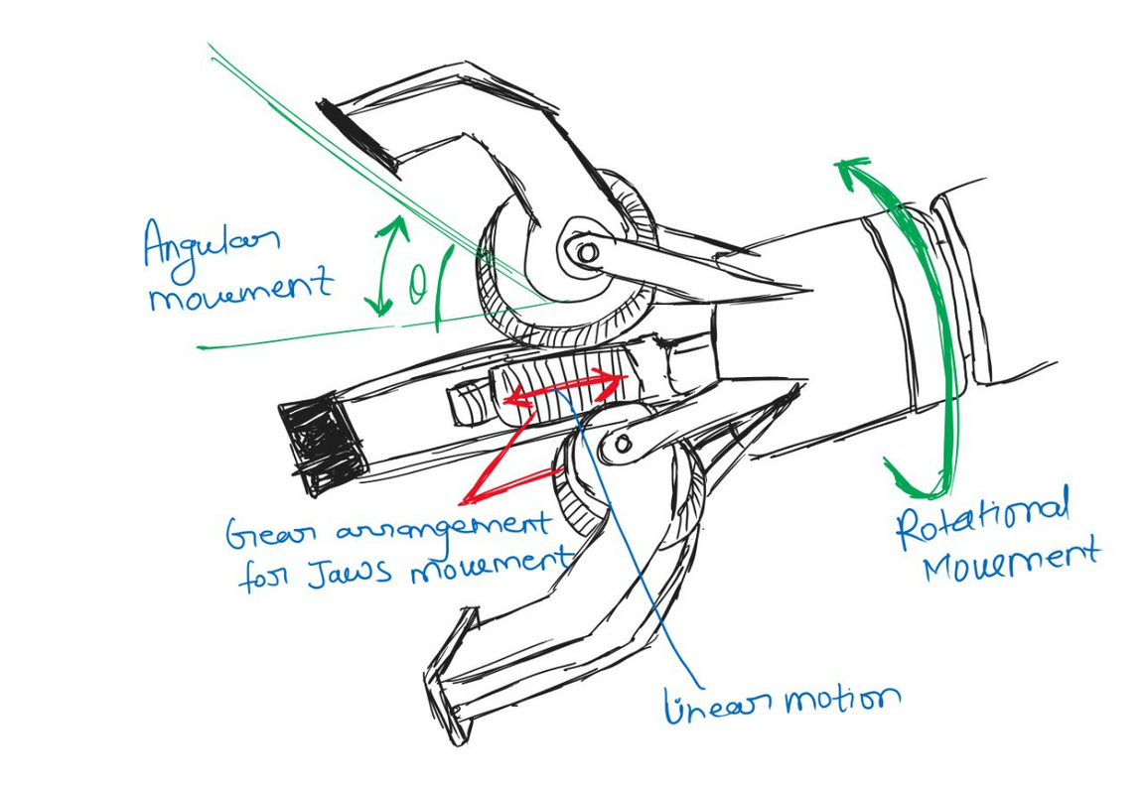
3 Jaw Pneumatic Gripper
Releasing the object
When compressed air is passed double acting cylinder, the rod moves outward, which opens the gripper
Holding the object
When the already filled compressed air is passed double acting cylinder, the rod moves inwards, which closes the gripper
Components
01
Ball Screw Arrangement (Stepper motor )
02
Three jaws
03
Gear arrangement for Jaw movement

Slide 5
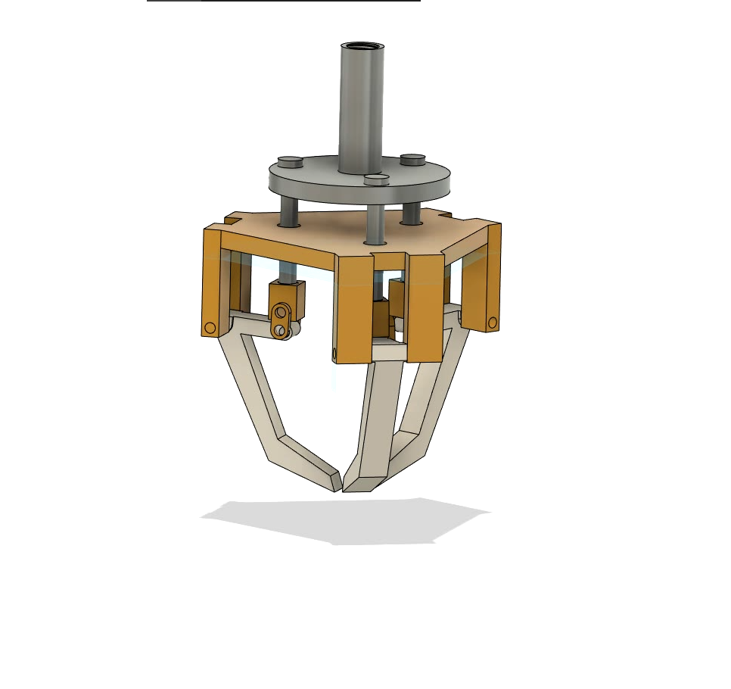
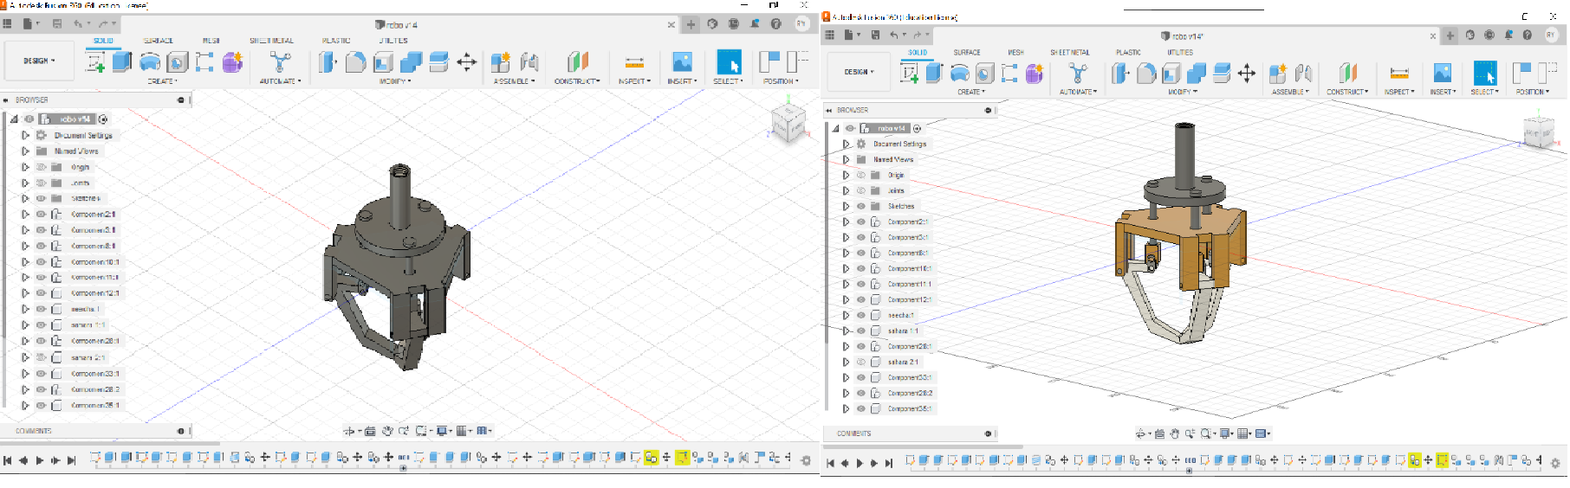
3D Model
APPLICATIONS

Slide 6
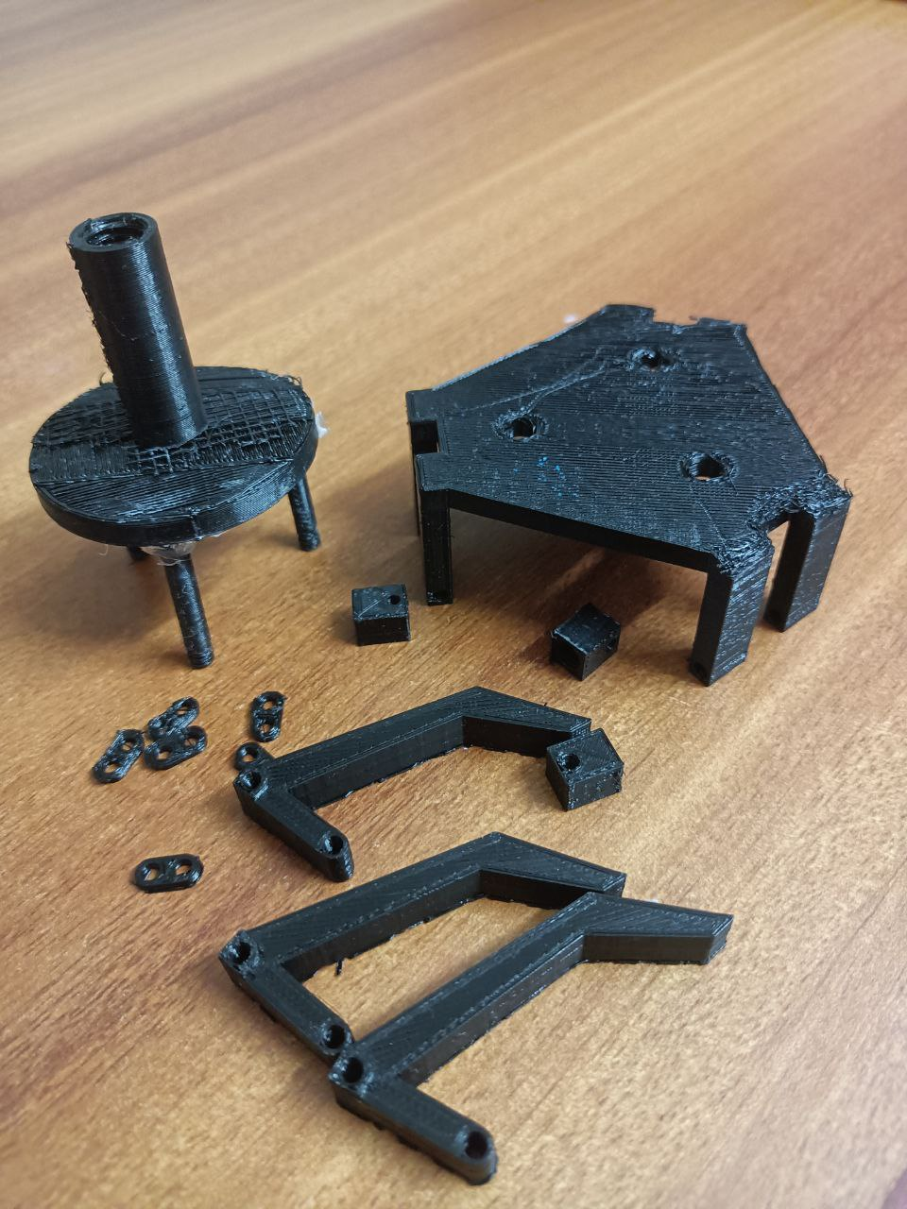
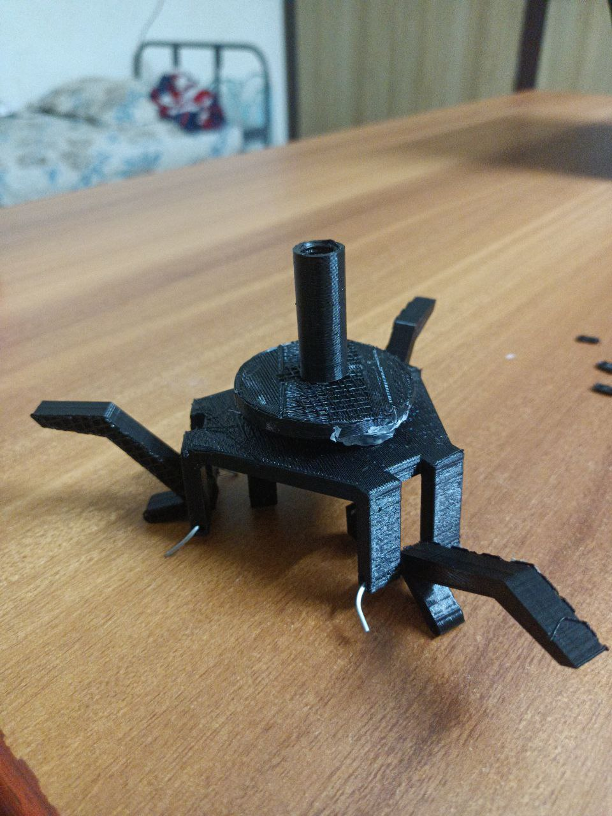
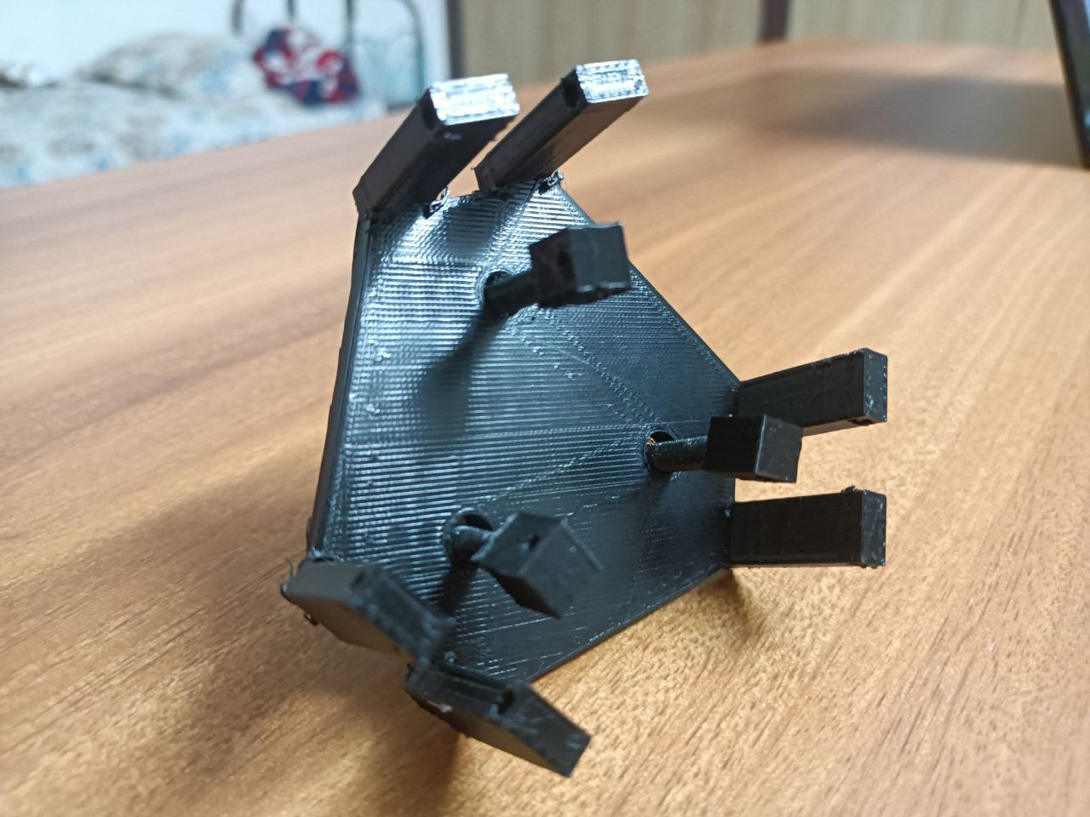
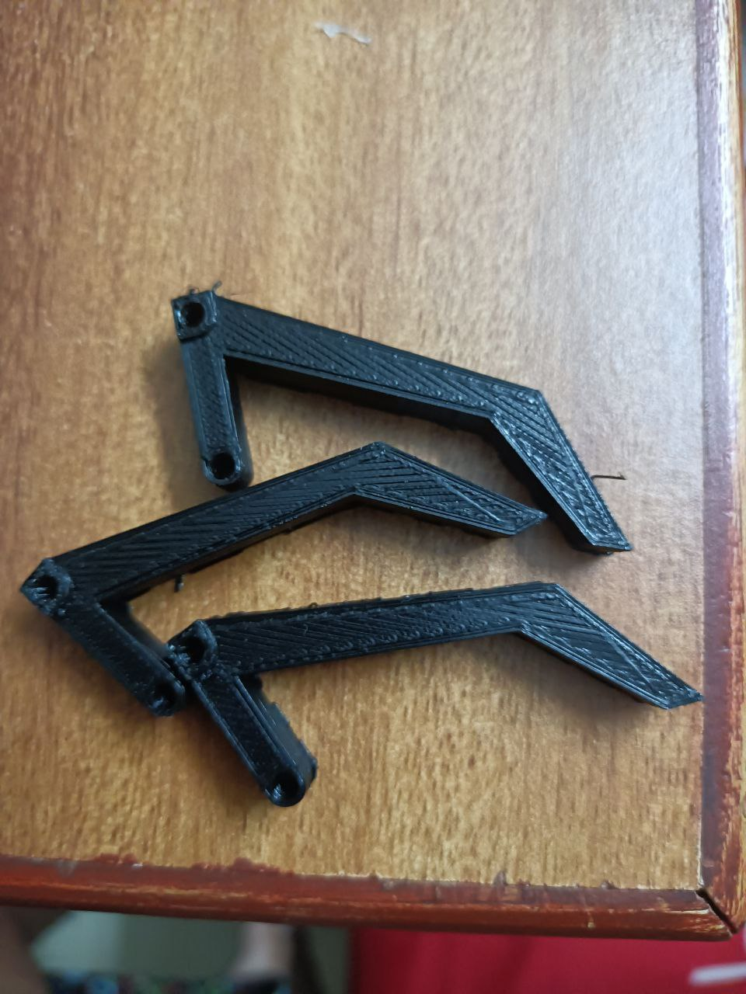
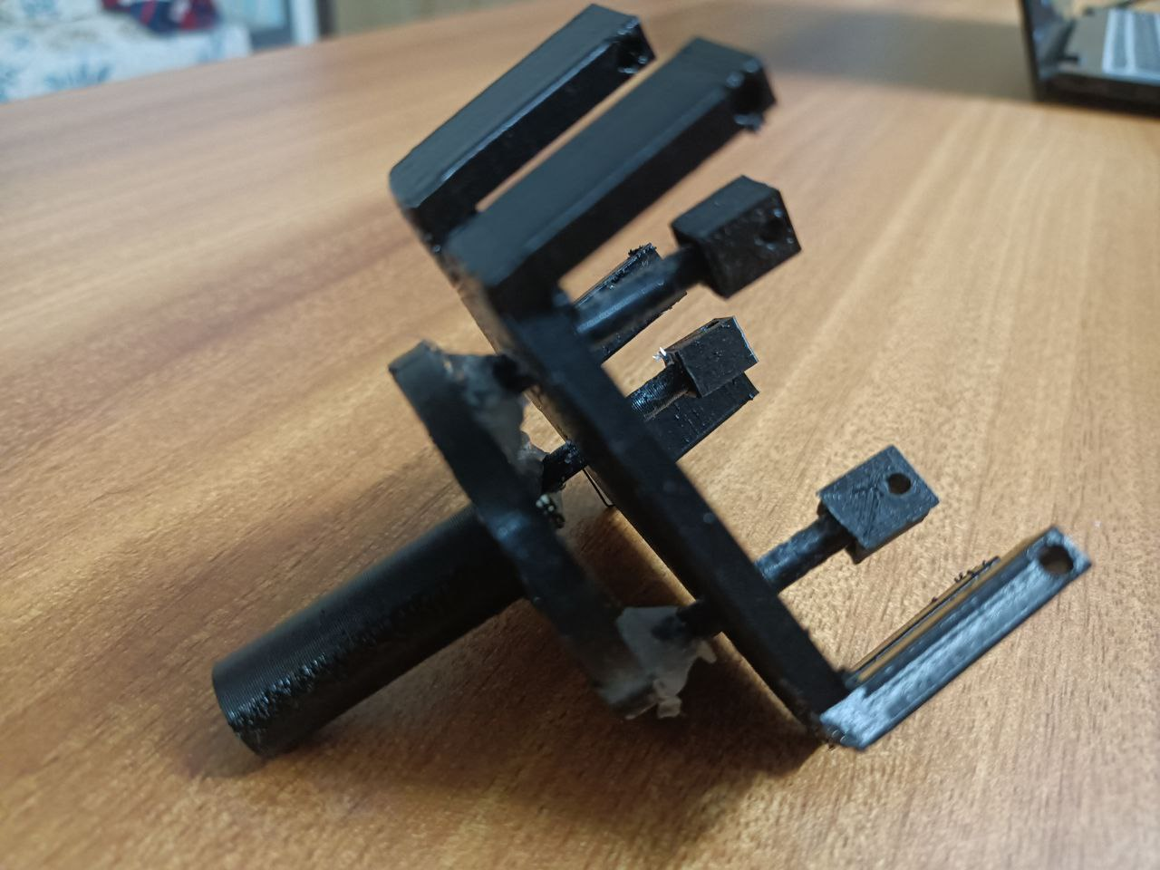
ASSEMBLING

Slide 7
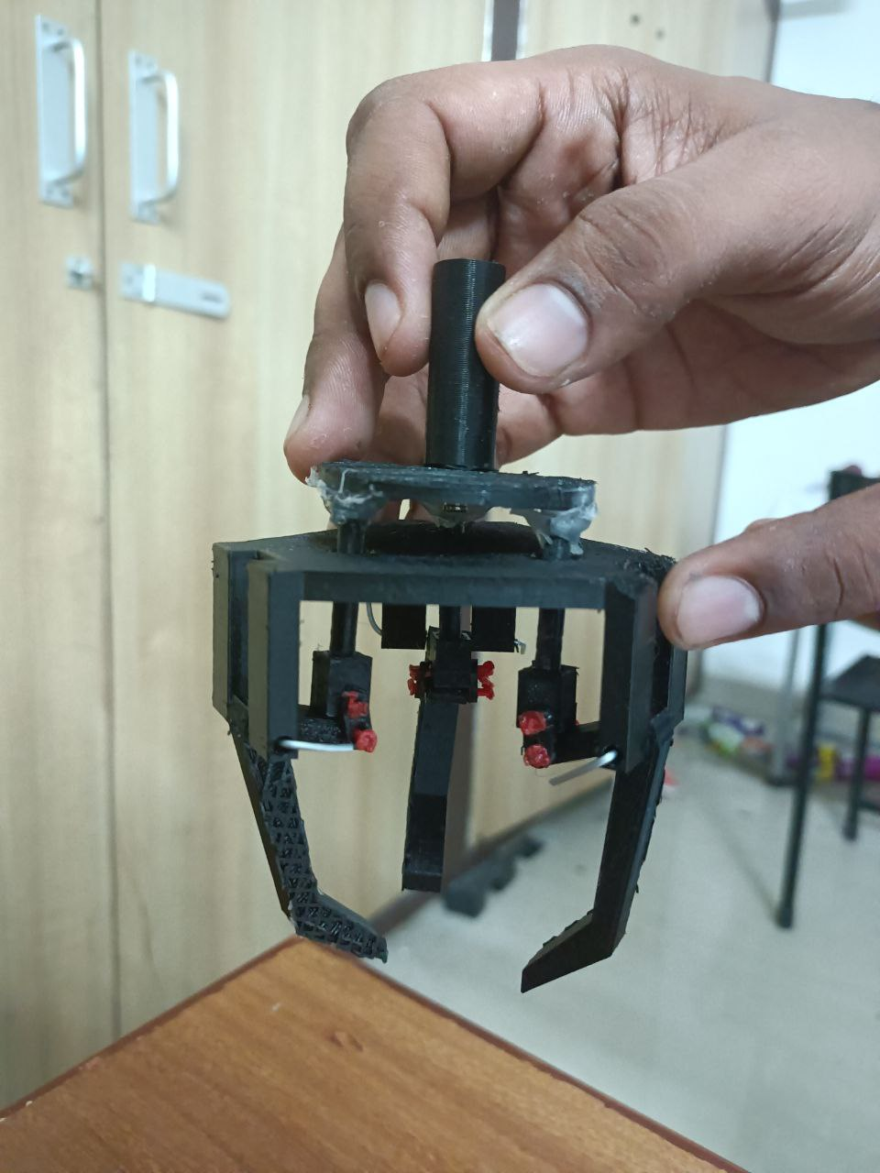
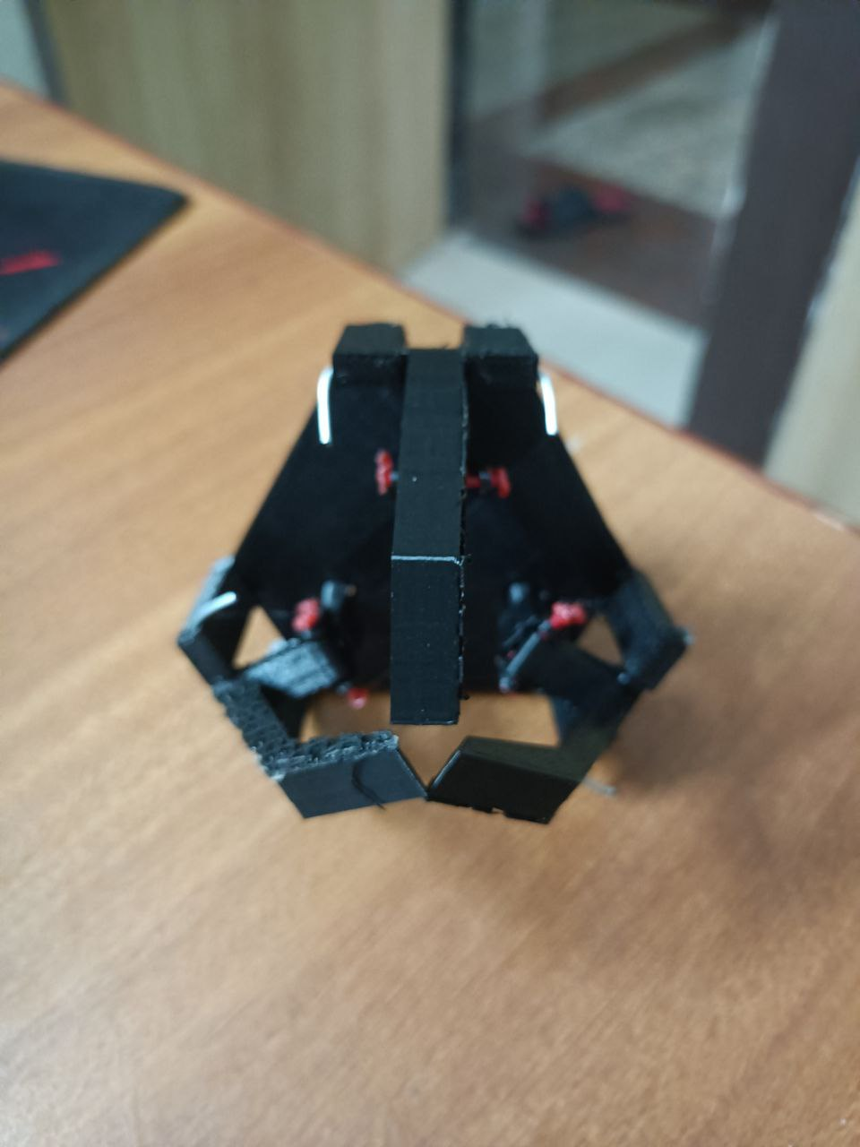
ASSEMBLED MODEL

Slide 8
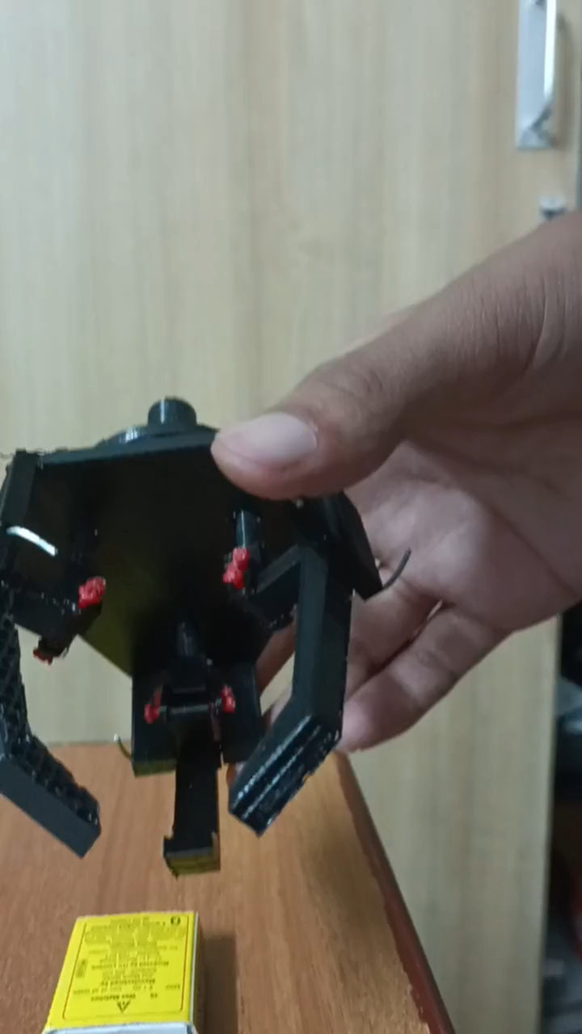
WORKING MODEL

Slide 9
LEARNINGS
APPLICATIONS
Always use fillets at joins before 3D printing
Threads diameter usually shrinks after 3D printing
Our 3 rod type parts whose diameter was lowest, got disengaged from base since fillets were not given on its joints
After 3D printing our model the thread diameters shrank
Simulation Helps
Testing of Durability of simulation is vital
After first simulation we observed that our jaw motion as restricted, the improvised the model and proceeded
Rubber can be placed at end to increase the grip

Slide 10
FUTURE SCOPE
An arrangement can be made to fix the gripper with actuator
On attaching the top of gripper to cylinder another arrangement is required to fit the fixed part of gripper with cylinder
The model can be scaled up
This model can be scaled up and can be used in relevant pick and place operation with robotic manipulators
Pneumatic actuator can be used to control the gripper
An pneumatic actuator can be attached with a scaled up version of this gripper and it can be controlled
Gripper end can be changed according to use
Rubber can be placed at end to increase the grip

